Slide 1





Module 06- Regular expressions
WWW.SELACLOUD.COM

Slide 2
Agenda
Concepts
RE characters
Search
Matching Object
Sub
Split
Finditer
Flags

Slide 3
Concepts About Regular Expressions
A regular expression is a pattern - a template - to be matched against a string.
Matching a regular expression against a string either succeeds or fails.
Sometimes, the success or failure may be all you are concerned about and sometimes we to process or to replace the matched pattern.
Regular expressions are widely used by many programs and languages
The module re provides full support for regular expressions in Python
Notes:
This is a straightforward solution for calculating the average of 2 numbers.
Notice the code in lines 3-5, repeated in lines 7-9.

Slide 4
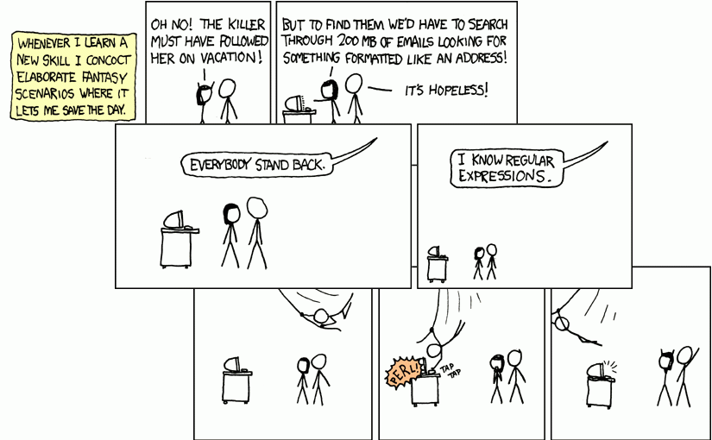
Notes:
This is a straightforward solution for calculating the average of 2 numbers.
Notice the code in lines 3-5, repeated in lines 7-9.

Slide 5
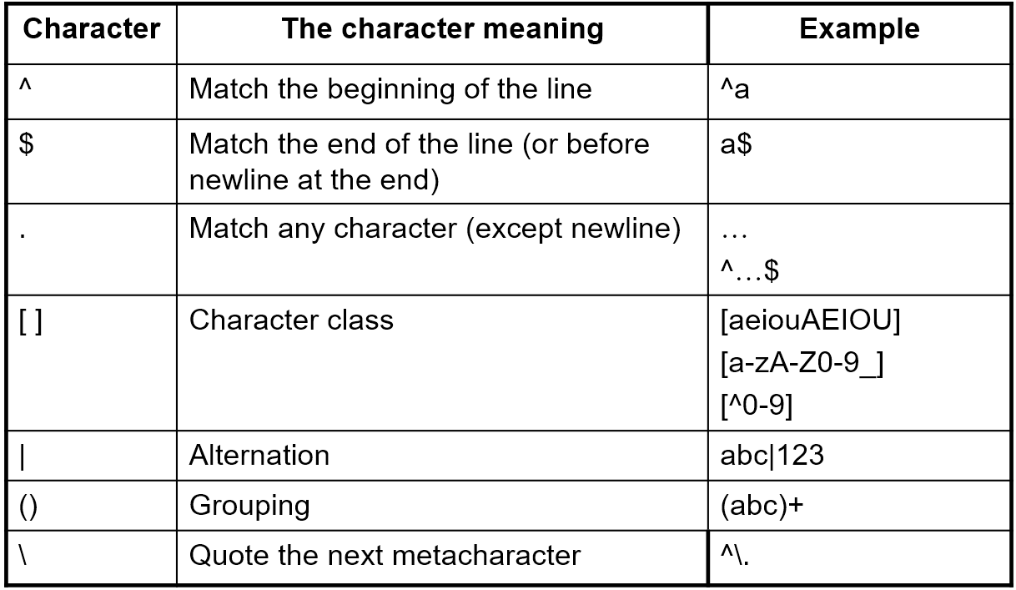
Regular- expression characters
There is the basic set of regular-expression meaningful characters in Perl.
Notes:
This is a straight forward solution for calculating the average of 10 numbers.
Notice now the code in lines 4-6 repeated more than once (3 times to be exact).
In real life, the size of data that programs deal with, is generally huge.
For example:
Bank system calculations
Seeking information on the web.
Image processing
Network traffic monitoring
etc…
It would be impractical to repeat the same few commands dozens, or hundreds or thousands of times.
Programs would become unreadable, error-prone and hard to fix.
There must be another solution for the repetition-of-similar-or-same-code problem!

Slide 6
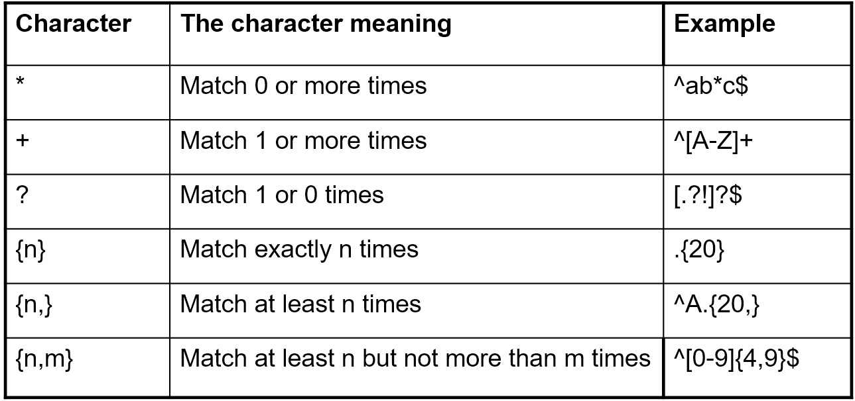
Regular- expression characters - Cont'd
There is the basic set of quantifiers characters:

Slide 7
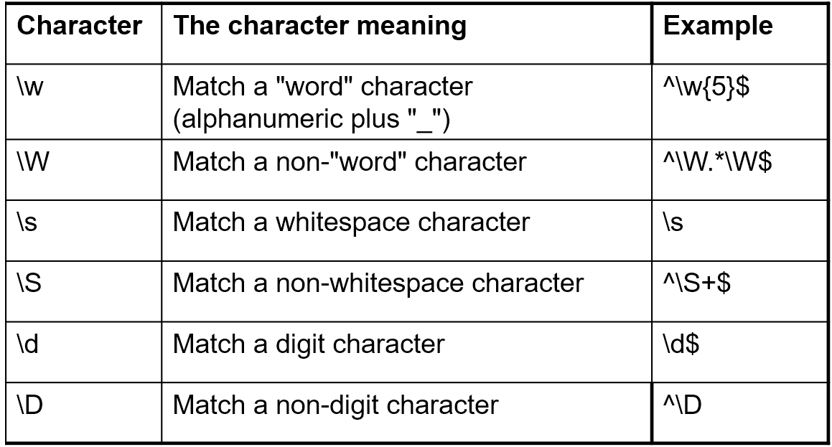
Regular- expression characters - Cont'd
There is the extended set of Python characters:
Notes:
A loop is a mechanism for defining the repetition of a code segment.
Each repetition is called an Iteration.
In this chapter we will learn about the following loop types:
The while loop
The for loop
These are not the only loop types in Python, but they are very common in most programming languages.

Slide 8
RE search
re.search - Scan through string looking for the first location where the regular expression pattern produces a match, and return a corresponding MatchObject instance
match_obj = re.search(pattern, string, flags=0)
pattern – regular expression
string – string to look pattern into
flags – possible flags
match_obj will be None if pattern didn't match
Notes:
The while keyword indicates the use of the while loop.
A condition is checked.
If the condition evaluates to true, a block of commands (enclosed in braces) is executed.
When the program is done executing the block, the condition is checked again.
The block will be executed again and again, as long as the condition
evaluates to true.
As soon as the condition turns to false the block is skipped.

Slide 9
RE search

Slide 10
RE search – cont'd
import re line = "my age is 22" m = re.search(r'(\d+).*', line) if m: print("matched string is {} in index ({},{})".format( m.group(1), m.start(1), m.end(1))) else: print("No match!!")
Notes:
Syntax
while 'condition': //colons at the end of the line to determine the beginning of the loop scope
one or more commands //in a slight indentation to the right
…
The slight indentation to the right defines all the commands meant for repetition into a
repeating block called the loop block (also known as loop body).
Action
The loop continues to iterate as long as the value of the condition is true.
The condition is re-evaluated before each repetition of the loop block.
In this case the condition is (number < 1000) and the loop block is in lines 3-4.
Important
Consider a loop in action.
What makes it stop?
If the program is executing the code in the loop, will it do so “forever”?
For the program to eventually exit the loop the condition must be false at some point.

Slide 11
RE search – cont'd
import re line = "27:11:2004" m = re.search(r'(\d+):(\d+):(\d+)', line) if m: print("matched day is {} in index ({},{})".format( m.group(1), m.start(1), m.end(1))) print("matched month is {} in index ({},{})".format( m.group(2), m.start(2), m.end(2))) print("matched year is {} in index ({},{})".format( m.group(3), m.start(3), m.end(3))) else: print("No match!!")
Notes:
The loop block (lines 3-7) consist of:
The commands the programmer wishes to repeat (lines 4-7)
Commands to make changes that will eventually turn the condition from true to false (line 7)
Now that we have the while loop in place, changing the number of times it is repeated (iterates) is very easy.
All we need to do is the change the condition (in this case, line 3) accordingly.
No change in the loop block is needed.

Slide 12
RE sub
re.sub – replaces all (or max) occurrences of the pattern in string. This method would return modified string
re.sub(pattern, repl, string, max=0)
pattern – regular expression
repl – replacement string
string – string to look pattern into
max – maximum replacements
Notes:
In line 8, the loop condition involves size which is known only during run-time.
Therefore, the programmer has no knowledge how many iterations will actually take place.
Question
How many iterations will the while repeat if 0 (zero) is entered as input for size (line 7)?
Answer
0 (zero) times.
This is because the while loop checks the condition counter <= size even before its first iteration.
Since the condition evaluates to false, there will not be even a single iteration of the loop.

Slide 13
RE sub

Slide 14
RE sub – cont’d
import re phone = "2004-959-559" # Remove anything other than digits new_phone = re.sub(r'\D', "", phone) print ("Phone num now is : ", new_phone ) #Phone num. now is : 2004959559 # Replace '-' with space new_phone = re.sub(r'-', " ", phone) print ("Phone num now is : ", new_phone) #Phone num now is : 2004 959 559
Notes:
In this example, a while loop is used for input-range check.
The calculation that starts in line 3 assumes that the score is within a certain range (0..100).
What if the input (line 2) is outside that range, say score = -5?
What is the meaning of line 6 then?
In order to validate the intended processing which starts in line 7, we use the while loop (lines 4-6) to repeatedly receive inputs as long as it is invalid.

Slide 15
RE split
re.split - Split string by the occurrences of pattern
re.split(pattern, string, maxsplit=0, flags=0)
pattern – regular expression
string – string to look pattern into
maxsplit – maximum splits
flags – possible flags
Notes:
In this case, the while loop will iterate as many times as there are digits in num.
This is because the operation num = num / 10 (line11) effectively eliminates num’s least significant digit.
This will continue until num has “no more digits”, meaning has the value of 0 (zero).

Slide 16
RE split

Slide 17
RE split – cont'd
The Output:
one
is
1
two
is
2
import re value ="one is 1, two is 2" result = re.split("[, ]+", value) for element in result: print(element)
Notes:
How do we limit the number of times the loop is executed?
In many cases, like the one in this slide, we use a counter that increases with every iteration of the loop.
At some point, the counter causes the loop condition to become false.
Is this a safe pattern?
What would happen if we forget to increment the counter?
The loop would iterate forever, and we will need to find that bug…
Is this problem avoidable in a different way than “don’t forget to increase the counter”?

Slide 18
RE split – cont'd
The Output:
1
22
3
value = "one 1 two 22 three 3" result = re.split("\D+", value) for element in result: print(element)
Notes:
For this purpose we can use a more suitable loop type – the for loop.
In the for structure, we write the initial state (count in x), the loop condition (count < x), and the iteration change (count++) all in one line.
This makes all the elements of the loop mechanism more visible.
Note
There is no difference in functionality between the while and the for loops.
The only difference between them is in the way we write them.

Slide 19
RE finditer
re.finditer - Return an MatchObject iterator for all matched patterns in string
re.finditer(pattern, string, flags=0)
pattern – regular expression
string – string to look pattern into
flags – possible flags
Notes:
Notice in “for (expr1 ; expr2 ; expr3)”:
expr1 is performed prior to the first iteration and only once during the entire execution of the loop.
expr2 is evaluated before the beginning of every iteration.
expr3 is performed after the completion of every iteration.
The loop ends when expr2 is evaluated as false.

Slide 20
RE finditer

Slide 21
RE finditer – cont’d
import re text = "this is a long sentence with a lot of words" for m in re.finditer(r"(\w+)", text): print('{}-{}: {}'.format(m.start(1), m.end(1), m.group(1)))
0- 4: this
5- 7: is
8- 9: a
….
35-37: of
38-43: words
Notes:
A 10 iteration loop will be titled the same way (line 1), regardless of the commands in the loop block.

Slide 22
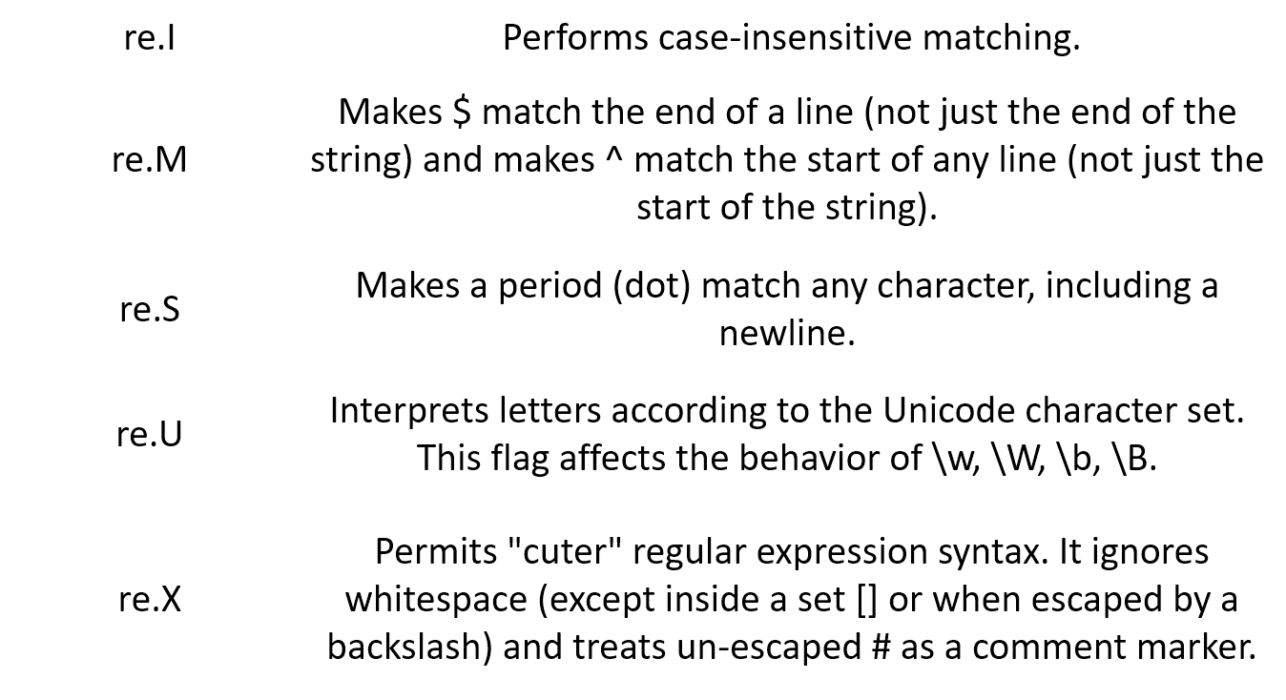
RE flags
Notes:
Notice that
the loop block (lines 3-5) contains only program-related commands and no loop-related command. This way, we won’t accidentally omit to increment the counter or perform any other loop-related statements.
"i" is initialized in the loop header (line 2). Therefore it does not need to be initialized in a declaration.
In that case, i will be unrecognized when used outside the loop
(compile-time error).
Q: Why does result need to initialized upon declaration (line 6)?

Slide 23
Labs 1-3

